Slide 1
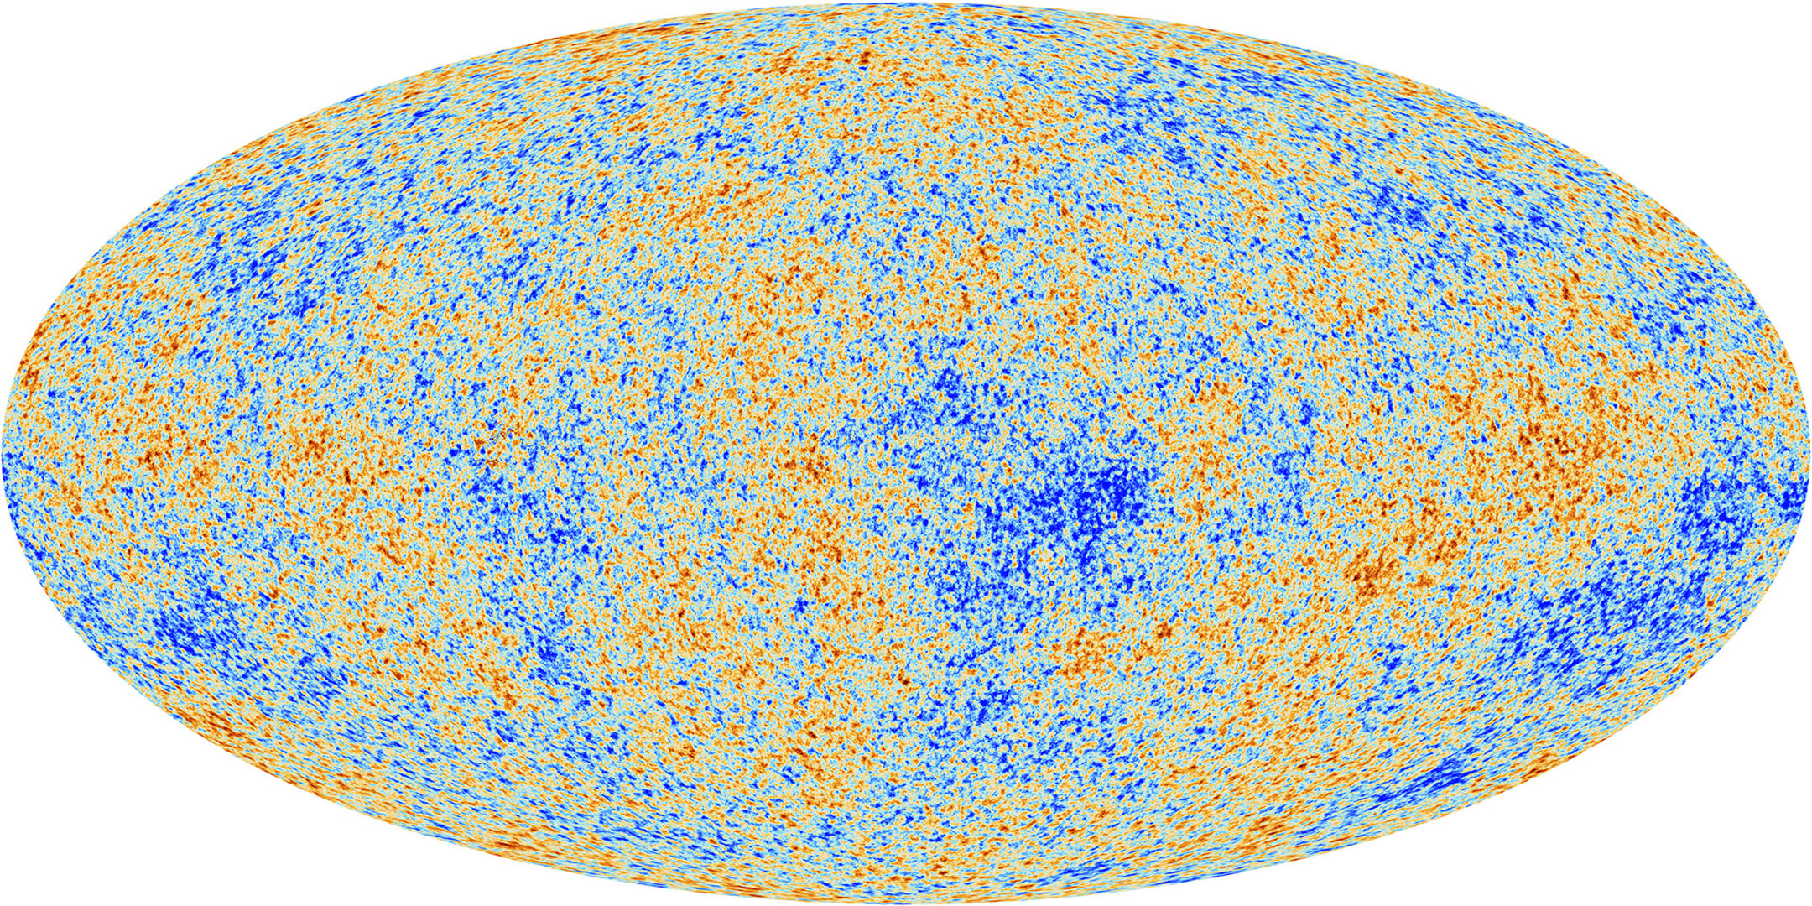
Physics of the CMB Angular Power Spectrum
CMB Summer School
University of Texas at Austin
May 8, 2024
Vivian Sabla
(inspired by “Physics of the CMB” by Yacine Ali-Haimoud)

Slide 2
Basic definitions
CMB = electromagnetic radiation permeating the Universe
Can be described by its intensity
$I(ν,\overset{̂}{n})$
or equivalently the phase space density/occupation number [# of photons per $d^{3}xd^{3}p$]
$$I(ν,\overset{̂}{n})=h^{4}ν^{3}f(ν)$$
direction of propagation
frequency
Notes:
So what is the CMB — it is electromagnetic radiation permeating the Universe and we need some tools to describe it.
Can be described by specific intensity which depends on frequency of the photon and on the direction of propagation
equivalently described by the photons phase space distribution f which is basically the number of photons per unit volume per unit cubic momentum/phase space volume
just to set the language

Slide 3
Basic definitions
[note: $ℏ=c=k_{B}=1$, $E_{γ}=hν$]
For a perfect blackbody at temperature T:
$$f=\frac{1}{exp(hν/T)-1}=\frac{1}{exp(E_{γ}/T)-1}$$
For generic radiation (non-blackbody), can always define T
$$T(E_{γ},\overset{̂}{n})=\frac{E_{γ}}{ln(1/f(E_{γ},\overset{̂}{n})+1)}$$
$T(ν,n)=T_{0}$ $+$ $ΔT(ν)$ + $ΔT(n)$ $+$ $ΔT(ν,n)$
spectral distortions
spectral-spatial distortions (ex. SZ)
anisotropies
Notes:
for non-blackbody, you can always define a temperature through this relation, even if its not a blackbody
What goes into the temperature: - monopole,
spectral distortions: decay of particles in the early universe or other statistical energy releasing processes

Slide 4
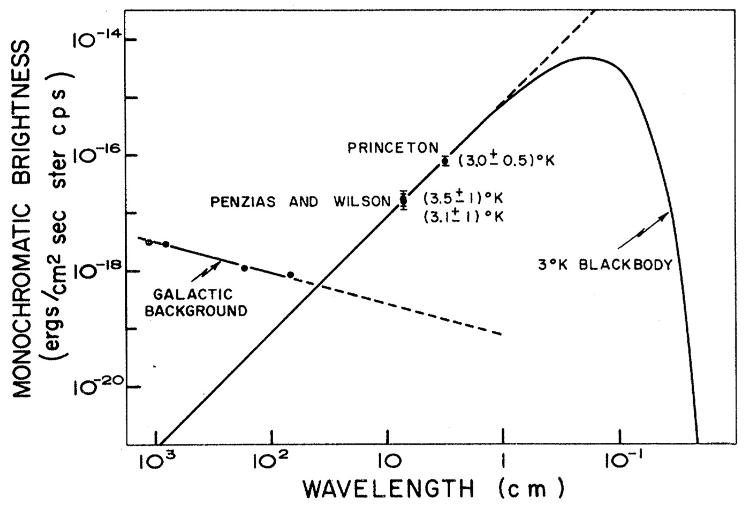
History of CMB Measurements
1966
1965
Roll & Wilkinson, 1966
Notes:
Penzias and Wilson detected this excess radiation which was interpreted as the CMB by Peebles, Dicke, Roll, Wilkinson

Slide 5
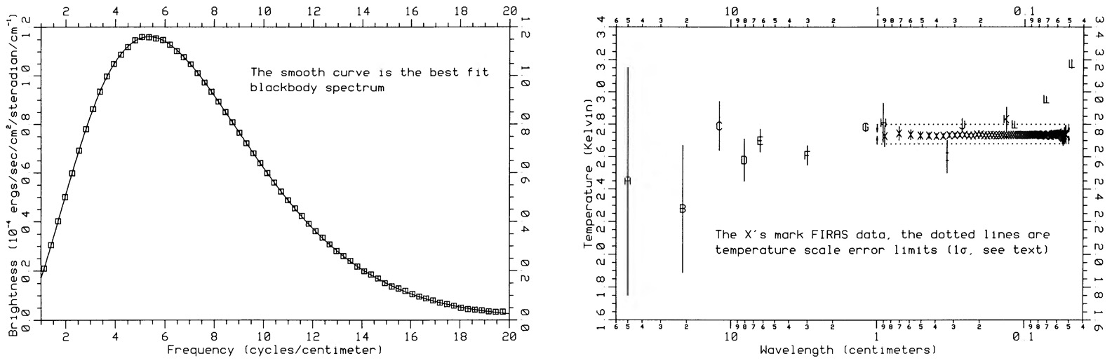
History of CMB Measurements
COBE measurement consistent with blackbody spectrum, i.e. spectral distortions <0.01% (Mather+ 1999)
COBE-FIRAS + other data (Fixsen 2009): $T_{0}=2.72548±0.00057K$
Mather+, 1990
COBE-FIRAS

Slide 6
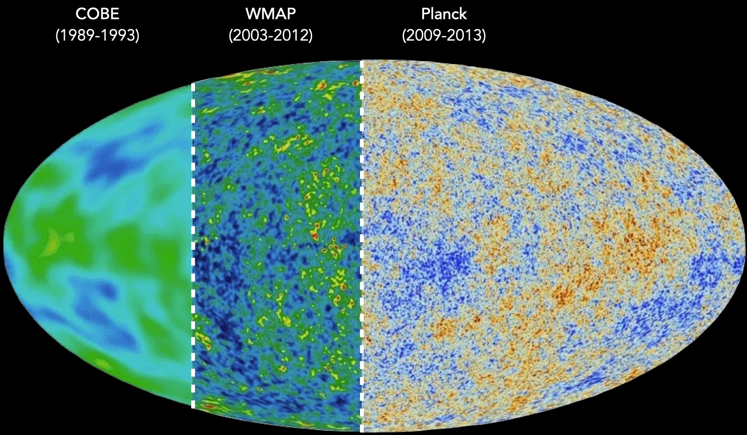
CMB Temperature Anisotropies
For now, we assume CMB has a perfect blackbody spectrum, focus on temperature fluctuations from one part of sky to the other
Notes:
ignore spectral distortions, assume perfect blackbody
first full sky map made by COBE
since then, we’ve got much higher resolution and gotten full sky maps from the WMAP and Planck, which opened up smaller and smaller scales.
of course as Nick talked about we also have polarization, but we’re not gonna focus on it.
how do we get physics out of this temperature map? We decompose it into spherical harmonics which I like to think of in the context/language of fourier transforms.

Slide 7
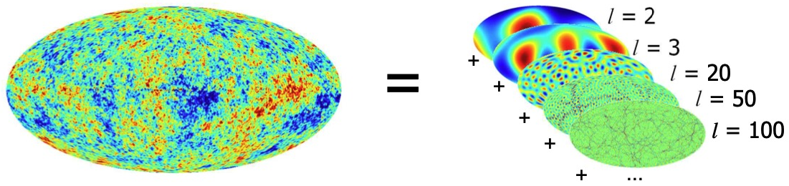
Spherical Harmonics
any function defined on a sphere may be expanded into spherical harmonics
$$Δ_{T}(\overset{̂}{n})=\overset{∞}{\underset{ℓ=0}{∑}}\overset{ℓ}{\underset{m=-ℓ}{∑}}a_{ℓm}Y_{ℓm}(\overset{̂}{n})$$
with the expansion coefficients given by
$a_{ℓm}=∫_{4π}Δ_{T}(\overset{̂}{n})Y_{ℓm}^{*}(\overset{̂}{n})dΩ$
Notes:
how do we get physics out of this temperature map? We decompose it into spherical harmonics which I like to think of in the context/language of fourier transforms.
A Fourier transform breaks down a superposition of multiple frequency waves into its constituent parts. A spherical harmonic does the same thing for angular fluctuations on different scales.
These expansion coefficients give the amplitude of fluctuations on different angular scales.

Slide 8
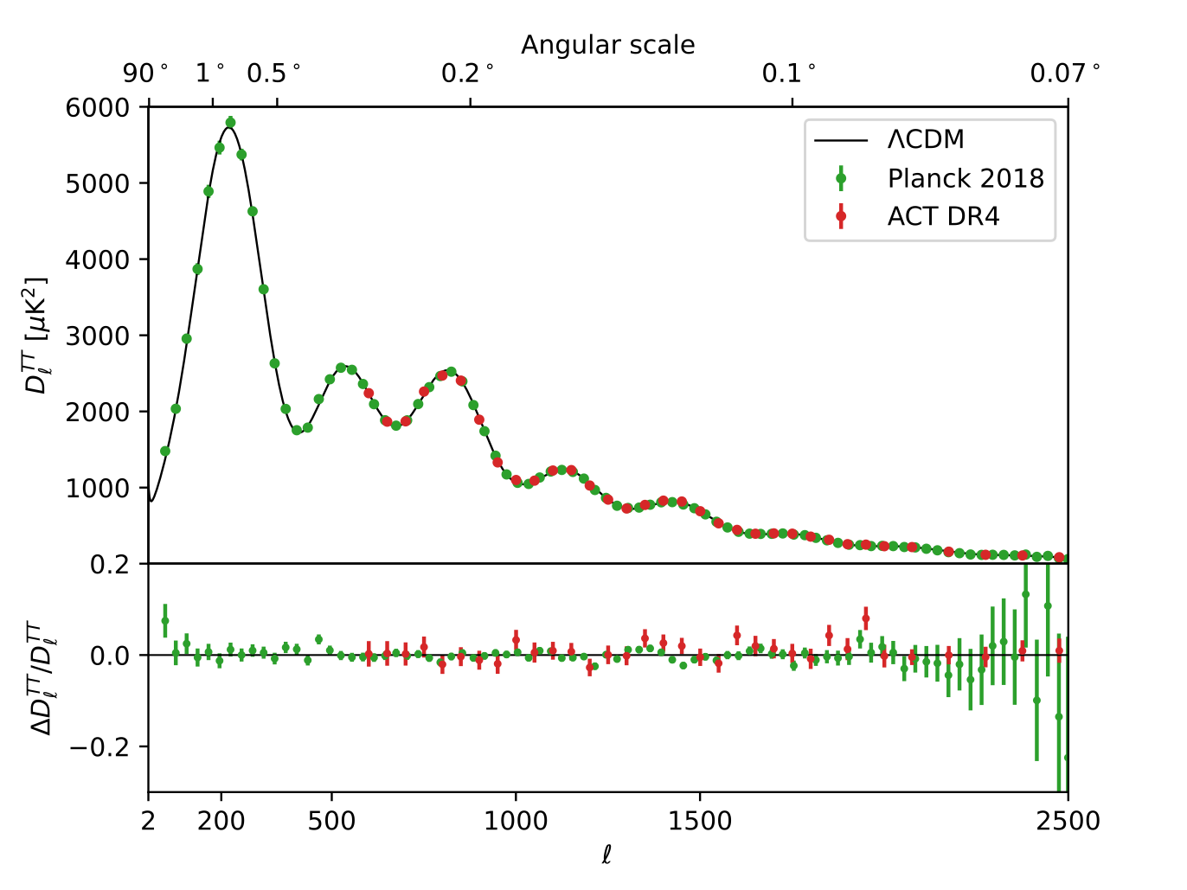
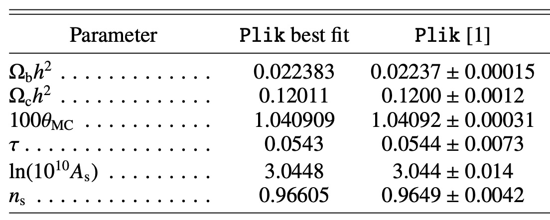
CMB Angular Power Spectrum
variance of temperature anisotropies as a function of angular scale
$$C_{l}=\frac{1}{2ℓ+1}\overset{ℓ}{\underset{m=-ℓ}{∑}}|a_{ℓm}|^{2}$$
$$D_{l}=\frac{ℓ(ℓ+1)}{2π}C_{l}$$
Notes:
So what your CMB angular power spectrum measures is the variance of temperature fluctuations across these different angular scales.
Each Cl represents the mean squared temperature difference at a particular angular scale, inversely proportional to the scale: smaller ell corresponds to larger angular scales, and larger l corresponds to smaller scales. This spectrum thus gives us a statistical measure of the strength of correlations at different angular separations, encapsulating the average behavior over the whole sky.
Mathematically the Cl’s are just the average of the squares of those expansion coefficients.
- When you take decompose measured temperature maps from our CMB telescopes, you get the green and red points here.
- But you can also calculate theoretically what the power should be given some cosmological model.
- It’s this incredible agreement between our data and our theory (with such small error bars) that has led the CMB to become the pillar of high-precision cosmology.
Gonna spend most of this talk discussing what goes into this black curve from a mostly qualitative perspective.
The theoretical model which is used to generate this curve is called the LCDM model, standard model of cosmology which depends on only six free parameters. One of the goals of this talk/workshop day will be to gain at least a basic understanding of how these parameters factor into the CMB spectrum.

Slide 9

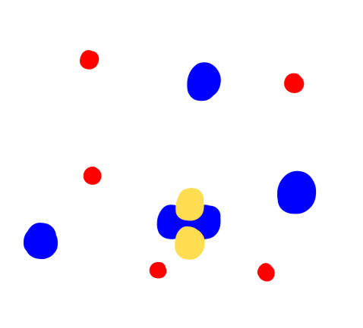
Primordial soup recipe
e-
p+
baryons
Notes:
In the early universe, the Universe was a lot hotter and denser than it is today and all the matter in Universe was freely floating in an ionized plasma. The energy/temperature was so high that neutral atoms could not form.
As you might expect one of the important components are the baryons, protons, electrons, Helium nuclei (way after BBN so we have some small percentage).

Slide 10

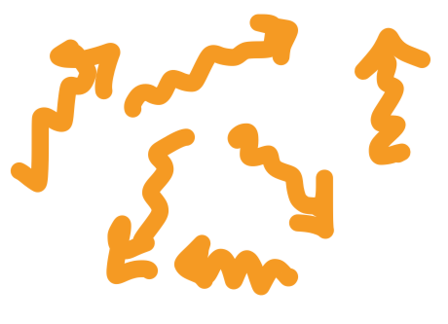
Primordial soup recipe
e-
p+
photons (CMB)
baryons
Notes:
Of course photons the main protagonist (~10^9 per hydrogen atom)

Slide 11


Primordial soup recipe
e-
p+
photons (CMB)
baryons
neutrinos
(collisionless, “hot”/relativistic)
Notes:
Neutrinos, almost as abundant as photons, but don’t interact at the times of interest for us so they are “collision less”. They are like dark matter in that they don’t interact, but they have a large residual thermal motion from the time they decouple (hot) at like 1 MeV.

Slide 12


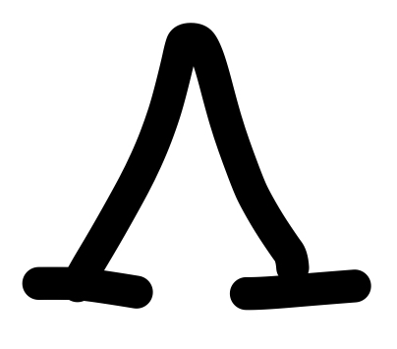
Primordial soup recipe
e-
p+
photons (CMB)
baryons
neutrinos
(collisionless, “hot”/relativistic)
cosmological constant
(“negative pressure”)
cold dark matter
(pressureless, collisionless)
Notes:
Then of course we have the dark sector, the dark matter and dark energy which for our purposes we describe as a cosmological constant with a sort of negative pressure. First introduced by Einstein in GR to counteract the gravitational pull of matter. Positive vacuum energy, negative equation of state, i.e. negative pressure.
Cold dark matter, don’t know what it is. Cold means pressure less, and dark means collision less (just like neutrinos).

Slide 13
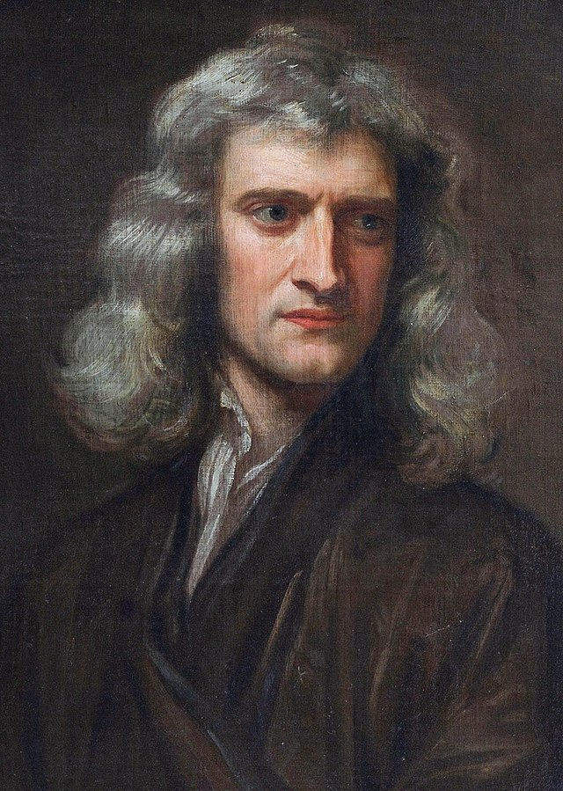
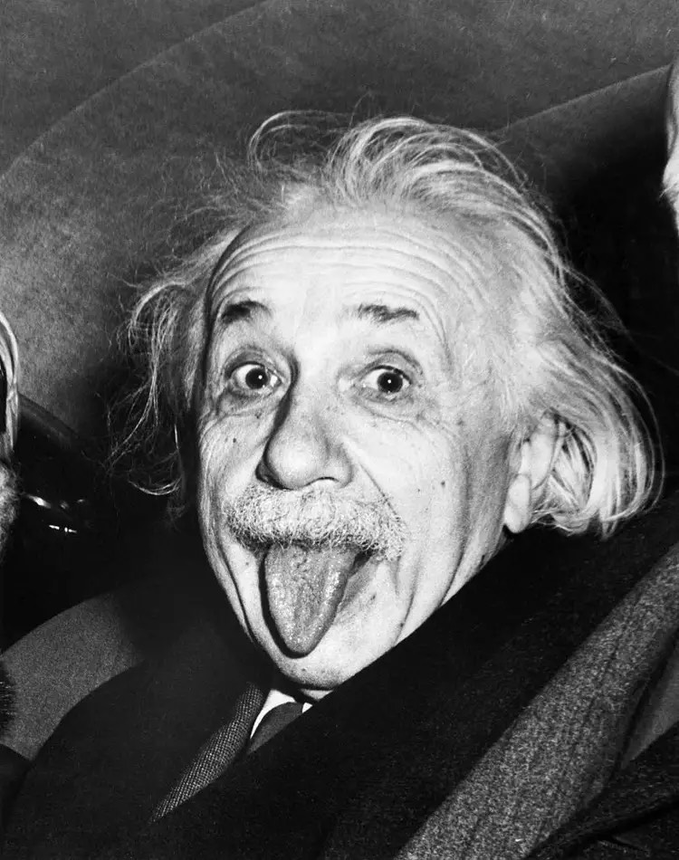
Primordial soup recipe
e-
p+
photons (CMB)
baryons
gravity
neutrinos
(collisionless, “hot”/relativistic)
cosmological constant
(“negative pressure”)
cold dark matter
(pressureless, collisionless)
Notes:
All of these pieces interact through gravity, or are connected through the laws of gravitation.

Slide 14
Primordial soup recipe
Thomson scattering
e-
first ~$3.8×{10}^{5}$ years
p+
photons (CMB)
baryons
gravity
neutrinos
(collisionless, “hot”/relativistic)
cosmological constant
(“negative pressure”)
cold dark matter
(pressureless, collisionless)
Notes:
And there is a special relationship between the photons and the baryons - they are coupled, or they exchange energy and momentum through Thomson scattering for the first 400,000 years or so.
Really what this means is that photons cannot travel very far before interacting with a baryon, i.e. they have a short mean free path. And the photons and baryons form a tightly coupled fluid that I will often refer to as the photon-baryon fluid.
As the Universe expands and cools, free protons and electrons can combine to form Neutral hydrogen, and Thomson scattering goes out of favor, meaning photons can freely stream without scattering.

Slide 15
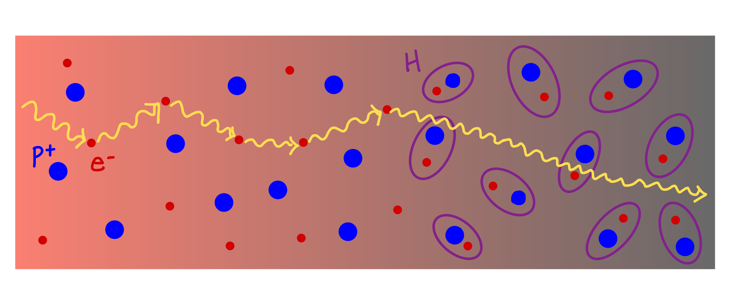
CMB Theory: history
380,000 yrs
time
temperature
CMB
“last scattering surface”
hotter, less dense
cooler, more dense
Notes:
Lets look at this on a timeline - in the first 400,000 years the Universe is totally ionized, and then it expands and cools and now the protons and electrons join together in neutral Hydrogen.
What Thomson scattering implies is that photons cannot travel very far before interacting with a baryon, i.e. they have a short mean free path. See this on the left. And through this coupling the photons and baryons form a tightly coupled fluid that I will often refer to as the photon-baryon fluid.
As the Universe expands and cools, free protons and electrons can combine to form Neutral hydrogen, and Thomson scattering goes out of favor, meaning photons can freely stream without scattering.
And all those photons that last-scattered off of the baryons form what is called the “last scattering surface” which has been freely streaming towards us and is what we now observe as the CMB.
This last scattering surface holds an imprint of the Universe at the time those photons last interacted with the electrons. While the photon-baryon fluid in the early universe was pretty uniformly dense, tiny density fluctuations left over from inflation imprint themselves on the CMB photons. Photons last scattered from over densities have to expend more energy to escape from the deeper gravitational potential wells and thus appear cooler than the photons escaping from under-densities.
This gives us our temperature anisotropies.

Slide 16
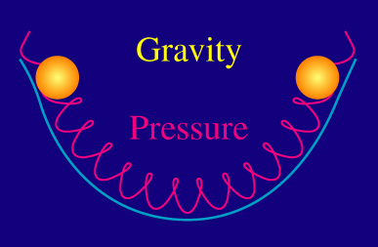
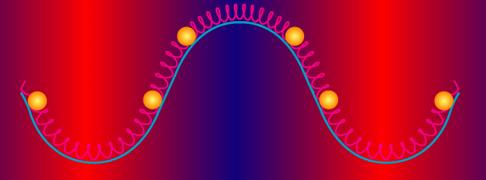
Acoustic Oscillations
temperature/density fluctuations have specific underlying structure generated by baryon acoustic oscillations
gravitational potential wells/hills seeded by dark matter
gravity pulls PBF into over-densities
radiation pressure pushes PBF out
recombination freezes these oscillations into place
Notes:
The hot and cold spots we see on the CMB temperature map may appear randomly distributed by they have a very specific underlying structure which is generated by what are called baryon-acoustic oscillations in the primordial plasma.
The BAO are the result of a beautiful tug of war between gravity and radiation pressure in the primordial plasma.
— I mentioned the over and under-densities. These over-densities or gravitational potential wells (shown in these images as the blue trough, are generally populated by dark matter.
— During those first 400,000 years, gravity pulls the photon baryon fluid into those gravitational potentials
— but because of the tight-coupling, photons come too and radiation pressure is built up, pushing the tightly coupled PBF out of the potential wells
— This process goes back and forth in the early universe, giving rise to oscillations in the density of the PBF which we call BAO due to their similarity to sound waves traveling through a medium
— As soon as “recombination” happened, these oscillations stop and the distribution of matter at that point gets frozen into the CMB photons which carry away that small temperature difference based on where they last scattered off of matter.
And the series of peaks and troughs we see in the angular power spectrum are exactly the imprint of the BAO.

Slide 17
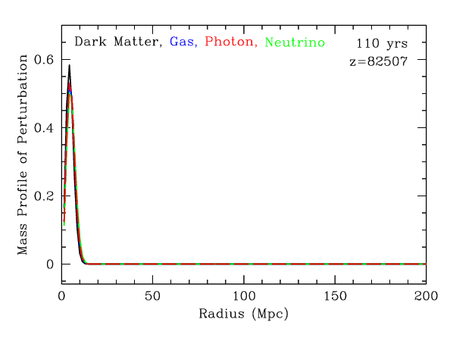
Sound waves in the early Universe
evolution of an initial overdensity
adiabatic initial fluctuations: equal perturbations in number density
normalized so curves of the same height have same fractional perturbation (not density)
From Daniel Eisenstein: https://lweb.cfa.harvard.edu/~deisenst/acousticpeak/acoustic_anim.html
Notes:
Let’s look at how one of these over-densities evolves a little more closely.
This is my favorite graphic for understanding the CMB. And what this really highlights is the Baryon Acoustic peak.
Start with adiabatic IC set by inflation (which means equal perturbations in number density, not energy density) so where there is DM perturbation, there is perturbation in everything else.
Played around with normalization so each perturbation has equal amplitude, adiabatic is equal number density (not energy density) so wouldn’t actually be completely on top of themselves.
So this is just a nice animation which we’ll run forward in time.

Slide 18
Sound waves in the early Universe
evolution of an initial overdensity
DM stays mostly where it is (structure formation beginning)
sound wave in photon-baryon fluid propagating outwards (pressure overdensity)
neutrinos free-streaming out at the speed of light
From Daniel Eisenstein: https://lweb.cfa.harvard.edu/~deisenst/acousticpeak/acoustic_anim.html
Notes:
Go back and take a look at what’s happening. Some time after we see that the radiation pressure has pushed the photon baryon fluid out of the initial matter over-density, but the photons and baryons are tightly coupled and so are evolving together. What you see here is the sound wave propagating out.
Neutrinos are free streaming out, slightly influenced by gravity but mostly traveling away relativistically.
What else is happening:
DM peak exerts some gravity on the other components so the amount of DM you have will influence the details of how this sound wave propagates.
Similarly the amount of photons, baryons and their relative densities will influence the details here as well. More photons, higher pressure, more baryons stronger gravity, etc.

Slide 19
Sound waves in the early Universe
evolution of an initial overdensity
photons decouple and begin free-streaming
baryons no longer dragged out by photons
From Daniel Eisenstein: https://lweb.cfa.harvard.edu/~deisenst/acousticpeak/acoustic_anim.html
Notes:
Fast forward to the time of recombination at redshift of 1100 and now the photons have decoupled from the baryons (red and blue no longer on top of each other.
Photons escaping, baryons stuck there at a radius of about 147 Mpc from the initial overdensity.

Slide 20
Sound waves in the early Universe
evolution of an initial overdensity
baryons fall back in initial DM peak
DM falls into baryon peak
From Daniel Eisenstein: https://lweb.cfa.harvard.edu/~deisenst/acousticpeak/acoustic_anim.html
Notes:
Run things forward, and the photons are going on their merry way.
On the left, baryons falling back into the DM potential well, and you also have DM falling into this baryon potential well over at a radius of 150 Mpc

Slide 21
Sound waves in the early Universe
evolution of an initial overdensity
baryons and DM trace each other
BAO peak at 150 Mpc
From Daniel Eisenstein: https://lweb.cfa.harvard.edu/~deisenst/acousticpeak/acoustic_anim.html
Notes:
And we can fast forward to today where we see the baryons and the DM distributions are nearly on top of each other again, and we have this BAO peak at 150 Mpc from the original over density.

Slide 22

CMB Theory: play (sound waves in the early Universe)
From Adam Hincks: https://adh-sj.info/bao_cmb.php
Notes:
How does this translate to the pattern we see in the CMB?
Well there are these Gaussian initial density fluctuations interspersed throughout the Universe, and each one evolves similarly to what we just saw creating this density peak at a radius of around 150 Mpc.
For each initial density peak you get one “blob” that looks like this, and when you add up all those different blobs coming from different initial fluctuations you get something that looks like the CMB.
Here you can think of the white as over density, black as underdensity evolving in the opposite direction and as you put these on top of each other, hey its the CMB.
Note you could have these smaller blobs where your initial over density wasn’t exactly the maximal case we looked at right, so maybe the over density didn’t really start evolving until later so the sound wave didn’t have as much time to propagate outwards.
So what you’re seeing is whatever that initial density fluctuation spectrum is (Gaussian random noise) convolved with all those BAO sound wave shells around each one, which turns into the CMB angular power spectrum we are used to seeing.

Slide 23
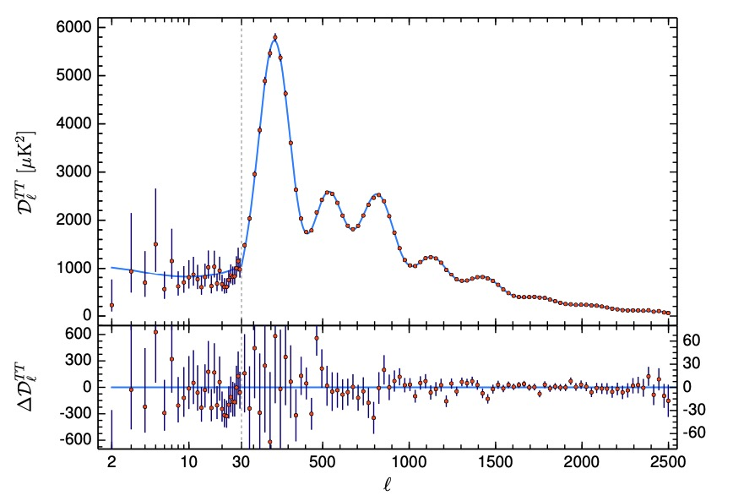
Acoustic peaks
peaks represents the points of rarefaction and compression in the sound waves
1st peak: largest scale a sound wave could travel before recombination
subsequent peaks: higher harmonics
odd peaks = compressions even peaks = rarefactions
$$θ_{s}=\frac{r_{s}}{D_{A}}$$
$$r_{s}∼150Mpc$$
From Planck 2018 results
Notes:
— Where all those spherical shells of sound waves turn into bessel functions which give rise to this oscillatory pattern we see in the CMB.
— each peak corresponds to a different mode of oscillation or different harmonic

Slide 24
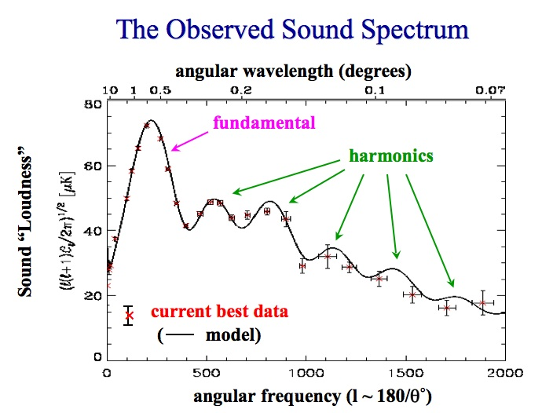
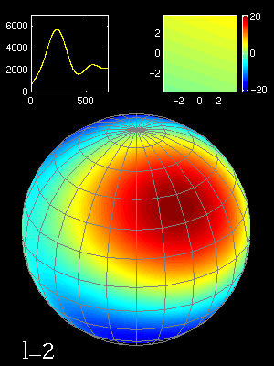
Acoustic peaks
peaks represents the points of rarefaction and compression in the sound waves
From Mark Whittle
Notes:
— Where all those spherical shells of sound waves turn into bessel functions which give rise to this oscillatory pattern we see in the CMB.
— each peak corresponds to a different mode of oscillation or different harmonic

Slide 25
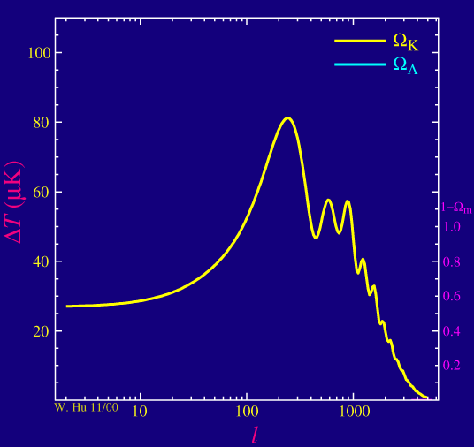
First peak
location is most well-measured part of spectrum, gives $θ_{s}$
position consistent with flat Universe i.e. no spatial curvature
height/shape depends on total matter density
flatness suggests high dark energy density
location changes with $H_{0}$, $Ω_{k}$

Slide 26
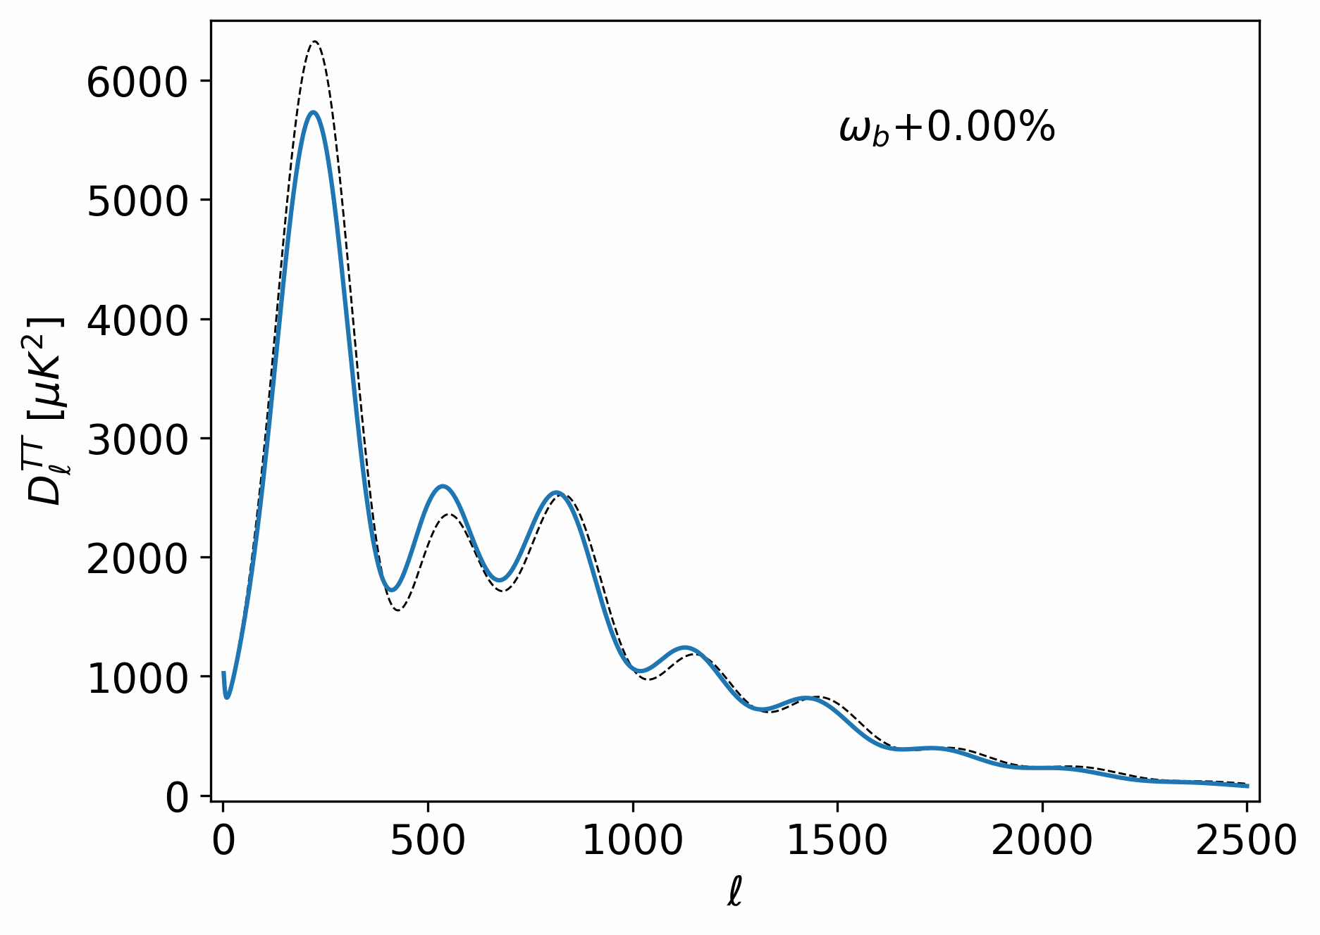
Second peak
existence evidence of sound waves
relative height w.r.t 1st peak give baryon density
increase inertia in photon-baryon fluid
- enhance amplitude of odd “compression” peaks
- oscillation frequency decreased
Notes:
Baryons (or ordinary matter) load down the photon-baryon plasma and add inertial (and gravitational) mass to the oscillating system.
Since the odd numbered (first, third, fifth...) acoustic peaks are associated with how far the plasma "falls" into gravitational potential wells (how much the plasma compresses), they are enhanced by an increase in the amount of baryons in the universe. The even numbered peaks (second, fourth, sixth) are associated with how far the plasma "rebounds" (how much the plasma rarefies). Thus with the addition of baryons the odd peaks are enhanced over the even peaks. For example, baryons make the first acoustic peak much larger than the second. The more baryons the more the second peak is relatively suppressed.

Slide 27
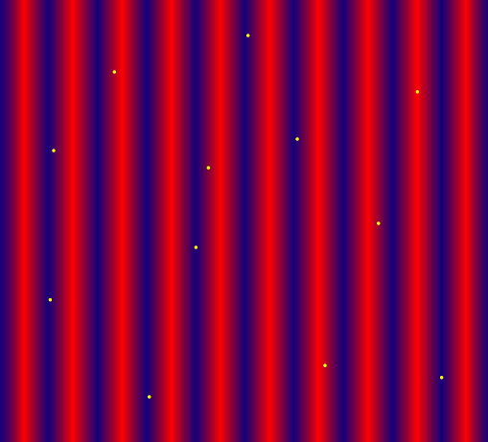
Higher peaks and Damping Tail
sensitive to ratio of dark matter density to radiation density
third peak separates baryonic and DM effects
small-scale fluctuations suppressed due to photon diffusion
damping tails constrains the rate of recombination ($Ω_{b}h^{2}$, $N_{eff}$, …)
Notes:
as the mean free path of photons becomes large during recombination era (not instantaneous), photons start diffusing out of potential wells, mixing “hot and cold” regions and smoothing out temperature fluctuations particularly on small-scales where the physical scale of fluctuations are so small that they are comparable to the distance that photons travel during recombination.

Slide 28
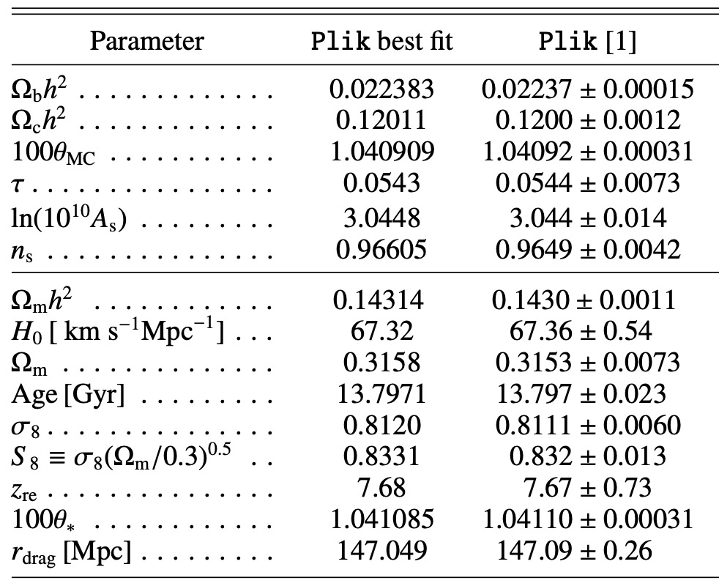
$Λ$CDM Model Constraints
To get theory curve: (read Dodelson Ch. 4-8 and Ma+Bertschinger)
set theory parameters
evolve background and Boltzmann equations for perturbations $\frac{∂f}{∂τ}+\frac{dx^{i}}{dτ}\frac{∂f}{∂x^{i}}+\frac{dq}{dτ}\frac{∂f}{∂q}+\frac{dn_{i}}{dτ}\frac{∂f}{∂n_{i}}={\left(\frac{∂f}{∂τ}\right)}_{C}$
integrate perturbations along line-of-sight
calculate power spectrum
Notes:
We’ve now got this qualitative picture of what goes into the CMB, and how some of the different cosmological parameters influence the theory curve, but how do you actually calculate it.
I’m not gonna tell you, thats a semester long course that involves knowing GR and doing some perturbation theory. But I’ll outline it here.
Boltzmann equations are a set of coupled differential equations that describe the evolution of particle distributions over time, taking into account couplings between particles, gravitational interactions and the expansion of the Universe. In order to properly get the evolution of the photon distribution which gives us our CMB pattern, we need to simultaneously solve around 20-30 coupled first order differential equations. So this involves deriving initial conditions for each equation which are set by inflation, and then basically just integrating from some initial (very early) point in the Universe through to the time of recombination (and beyond) to get the anisotropy pattern as we would see it today.

Slide 29
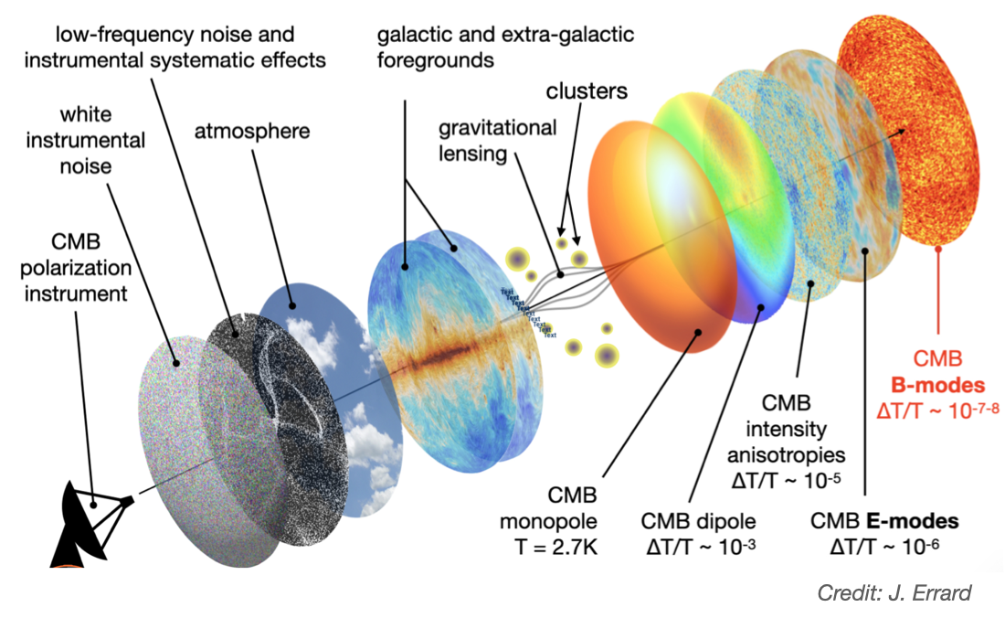
Observational Challenges
Contaminant astronomical/cosmological signals
Instrumental noise and effects
Secondary signals

Slide 30
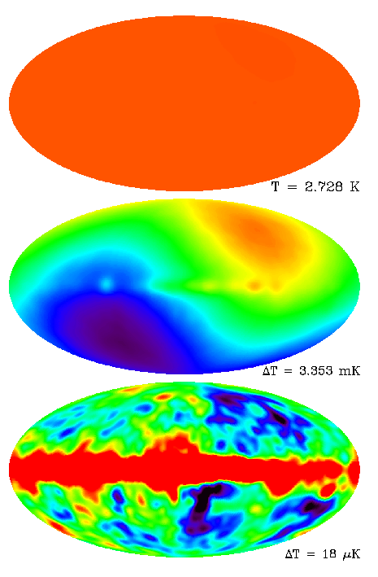
Astro/cosmo contaminants
Monopole and dipole
Notes:
Motion of earth and solar system with respect to galaxy and local galaxy group imprints a dipole pattern on the CMB.
Velocity of Earth with respect to the CMB rest frame: 371 km/s

Slide 31
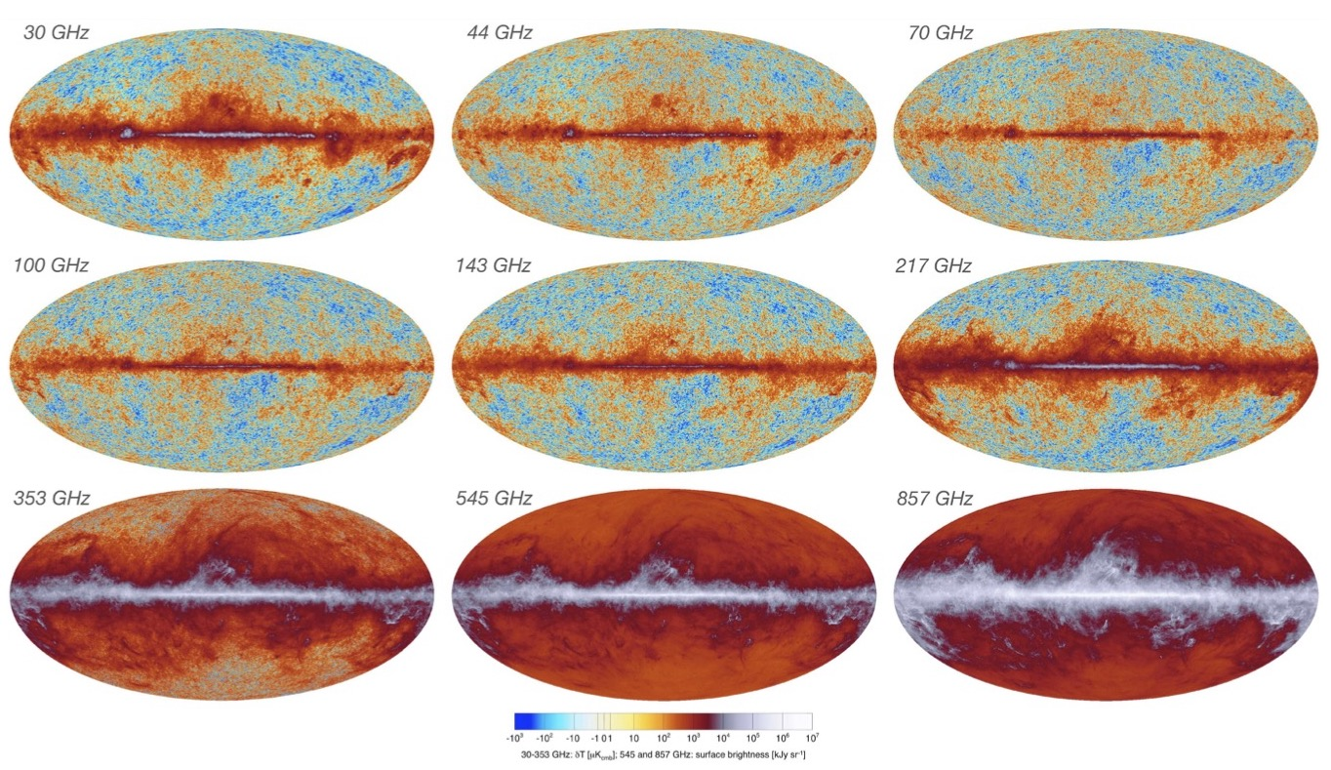
Astro/cosmo contaminants
Monopole and dipole $⟶$ subtract off
Foregrounds (galactic synchrotron emission, dust, extragalactic point sources, SZ)
Notes:
Different foregrounds dominate at different frequencies, but the CMB peaks at 160 GHz.
Low frequency bands give galactic synchrotron emission. Mid-range 70-143 are cleanest for anisotropy measurements. Dust dominates at high frequencies.
Take measurements at different frequencies, isolate the different contaminants, and do a semi-complicated internal linear combination to minimize the overall variance in the combined map, assuming that the CMB signal has the same temperature across all frequencies, while the foregrounds vary.

Slide 32
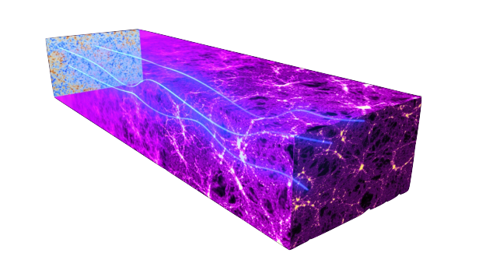
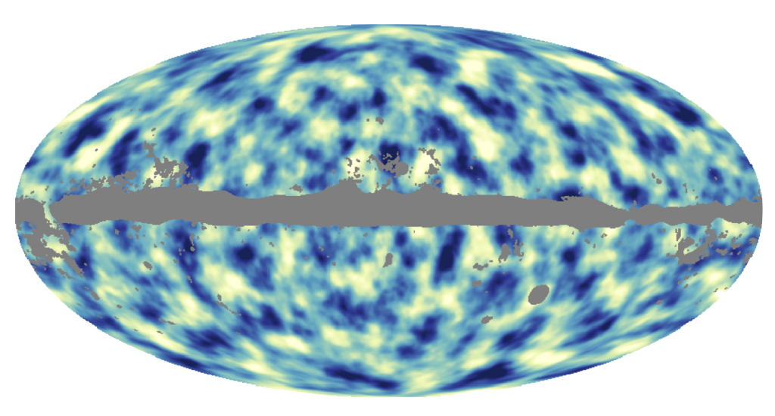
Astro/cosmo contaminants
Monopole and dipole $⟶$ subtract off
Foregrounds (galactic synchrotron emission, dust, extragalactic point sources, SZ) $⟶$ multi-frequency component separation
Gravitational lensing
Notes:
As CMB photons pass through large scale structure they get lensed, which distorts the temperature and polarization maps, generally smoothing out small-scale anisotropies.
Fixed by modeling or reconstructing the lensing potential from large scale structure surveys, and theories of structure formation.

Slide 33
Astro/cosmo contaminants
Monopole and dipole $⟶$ subtract off
Foregrounds (galactic synchrotron emission, dust, extragalactic point sources, SZ) $⟶$ multi-frequency component separation
Gravitational lensing $⟶$ model/reconstruct lensing potential from LSS
Cosmic variance
Notes:
Cosmic variance is an irreducible source of uncertainty - statistical uncertainty that results from the fact that we have a finite size and sample of our observable Universe.
On large angular scales, the observable Universe can only be divided into relatively few samples so statistical fluctuations can be significant.
It is only possible to observe part of the universe at one particular time, so it is difficult to make statistical statements about cosmology on the scale of the entire universe.

Slide 34
Astro/cosmo contaminants
Monopole and dipole $⟶$ subtract off
Foregrounds (galactic synchrotron emission, dust, extragalactic point sources, SZ) $⟶$ multi-frequency component separation
Gravitational lensing $⟶$ model/reconstruct lensing potential from LSS
Cosmic variance $⟶$ tough luck :(
Notes:
Cosmic variance is an irreducible source of uncertainty - statistical uncertainty that results from the fact that we have a finite size and sample of our observable Universe.
On large angular scales, the observable Universe can only be divided into relatively few samples so statistical fluctuations can be significant.
It is only possible to observe part of the universe at one particular time, so it is difficult to make statistical statements about cosmology on the scale of the entire universe.

Slide 35
Instrumental effects
Instrumental noise: thermal, electronic, atmospheric
Notes:
Thermal noise from the instruments themselves, electronic noise from the detector systems, and readout noise from the data acquisition process.
- thermal noise

Slide 36
Instrumental effects
Instrumental noise: thermal, electronic, atmospheric
minimized with cryogenics, shielding, site-selection
modelled and removed
Notes:
Thermal noise from the instruments themselves, electronic noise from the detector systems, and readout noise from the data acquisition process.
- thermal noise

Slide 37
Instrumental effects
Instrumental noise: thermal, electronic, atmospheric
minimized with cryogenics, shielding, site-selection
modelled and removed
Sky coverage - impacts angular scales available (minimum $ℓ$)
Notes:
sky coverage typically impacts the angular scales available in measurements, and the statistical uncertainty of those measurements (particularly at large angular scales).
Often a balance to be struck between covering a wide area and higher resolution at small scales.

Slide 38
Instrumental effects
Instrumental noise: thermal, electronic, atmospheric
minimized with cryogenics, shielding, site-selection
modelled and removed
Sky coverage - impacts angular scales available (minimum $ℓ$)
Beam size/aperture - impacts maximum $ℓ$, angular resolution
Notes:
Beam size essentially determines angular resolution or the smallest angular size on the sky that the telescope can resolve (maximum ell).
Smaller beam size, narrower beam, higher angular resolution (small scale sensitivity),
Generally a balance to be found between sky coverage, beam size, etc to get large scales but also good resolution on small scales.
SO has LAT and 3 SATs to get both small and large scale info

Slide 39
Useful resources
Wayne Hu’s CMB tutorials: http://background.uchicago.edu/~whu/intermediate/summary.html (also check out his PhD thesis, its got basically everything)
BAO: — Daniel Eisenstein https://lweb.cfa.harvard.edu/~deisenst/acousticpeak/ — Adam Hincks https://adh-sj.info/bao_cmb.php
CMB Perturbation Theory: — https://cmb.wintherscoming.no/theory_perturbations.php — Ma & Bertschinger https://arxiv.org/abs/astro-ph/9506072

Slide 40
Workbook Sessions
Workbook 1: angular power spectrum to pristine T-map
Workbook 2: add foregrounds (point sources + SZ) to pristine T-map
Workbook 3: add instrumental effects
Workbook 4: compute “observed” power spectrum from messy T-map

Slide 42
EXTRA SLIDES

Slide 43
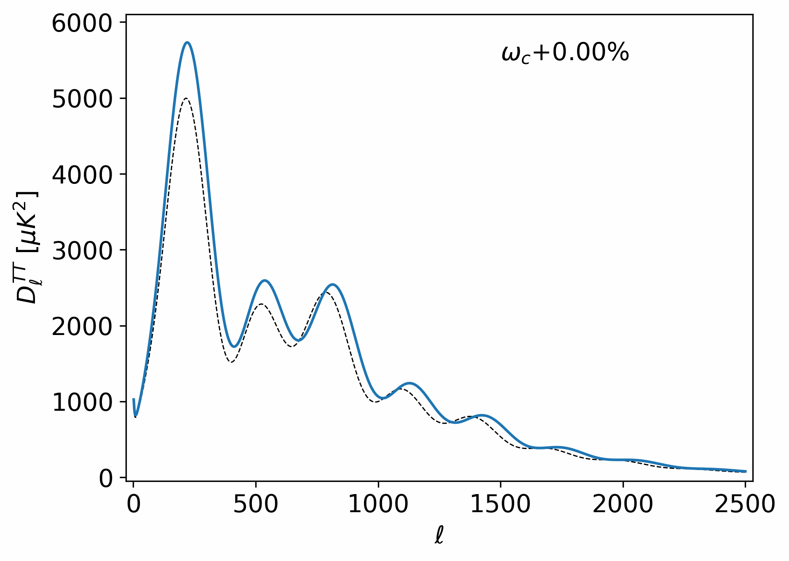
Dark matter density
deepens gravitational potentials
lower amplitude and frequency of oscillations
enhanced late-time growth of structure (enhanced Silk damping)
constrained by higher peaks
Notes:
with deeper gravitational potentials
— lower amplitude (lower 1st peak amplitude)
— smaller oscillation frequency is changed (pushed to small scales, high l)
— more DM also means you enhance the growth of structure later in the Universe

Slide 44
Baryon density
increase inertia in photon-baryon fluid
enhance amplitude of odd “compression” peaks
oscillation frequency decreased
mainly constrained by relative height of 1st and 2nd peaks

Slide 45

Hubble constant
increased expansion rate
decreases the angular diameter distance to LS
increases angular size of sound horizon
peaks stretched to small scales
degenerate with spatial curvature
Notes:
increase H0, decrease the angular diameter distance to the surface of last scattering, increases angular size of sound horizon, pushes to high l

Slide 46
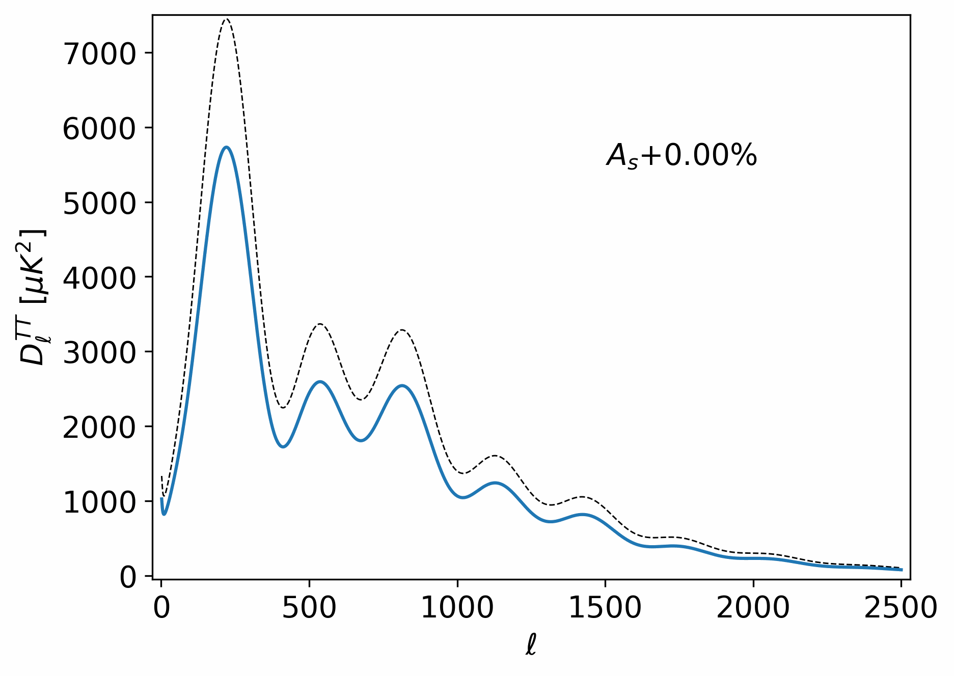
Scalar Amplitude
increased scale of initial temperature fluctuations
increases amplitude of the entire power spectrum
no change in location

Slide 47
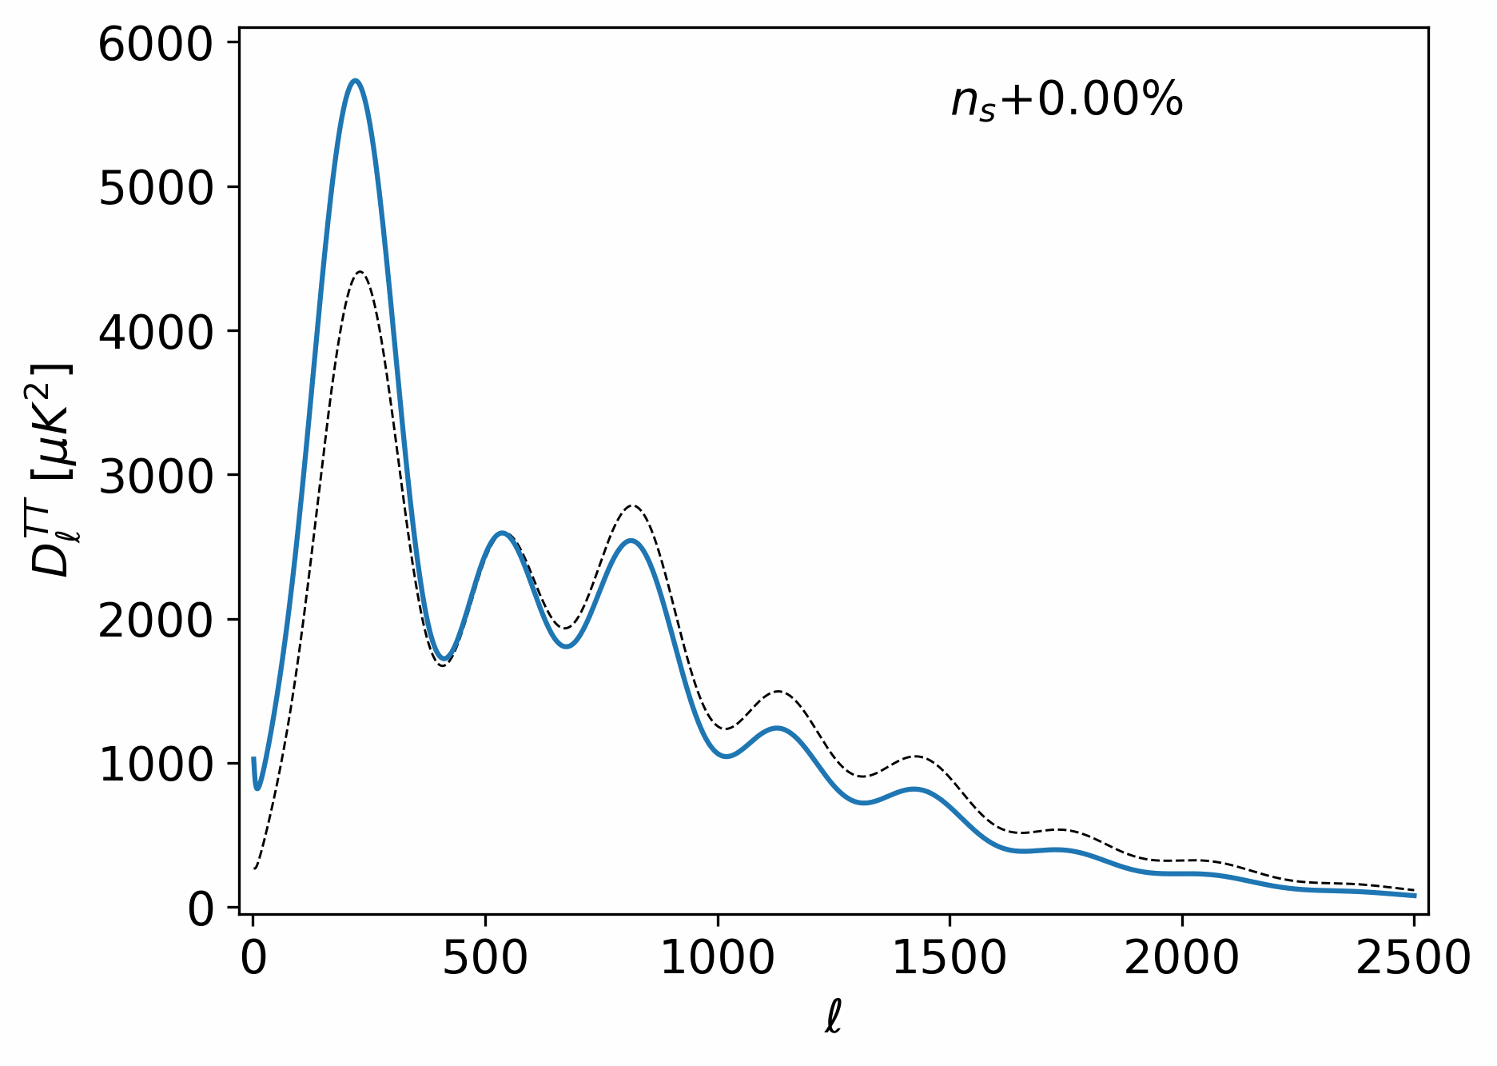
Scalar spectral index
increases initial power on small scales relative to large scales
higher order peaks enhanced
1st peak suppressed

Slide 48

Optical depth to Reionization
$τ$ quantifies how much CMB photons have been scattered by free electrons since reionization
more extensive scattering
overall suppression at all scales
fluctuations smoothed out
degenerate with scalar amplitude
Notes:
quantifies how much CMB photons have been scattered by free electrons since the Universe has become re-ionized once structure formed
quantifies how much CMB photons have been scattered by free electrons since reionization

Slide 49
Optical depth to Reionization
$τ$ quantifies how much CMB photons have been scattered by free electrons since reionization
more extensive scattering
overall suppression at all scales
fluctuations smoothed out
degenerate with scalar amplitude
Notes:
quantifies how much CMB photons have been scattered by free electrons since the Universe has become re-ionized once structure formed
quantifies how much CMB photons have been scattered by free electrons since reionization

